Slide 1
Cloud Migration Strategy
Phani Kishore Lanka

Slide 2
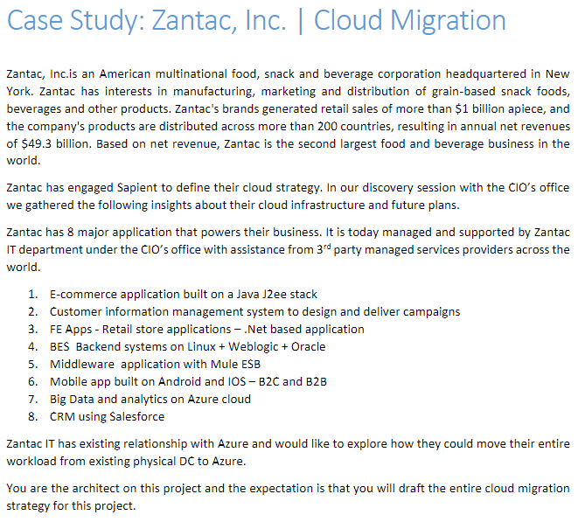
Requirements

Slide 3
Key Points
Giving Presentation in CIO’s office.
Zantech is 2nd Largest Food and Beverage Business, Revenue of close to $50 billion
Companies products distributed across 200+ countries
Apps is Highly Business critical and Revenue Generating, 0 downtime.
Apps are global and require less latency and resilience.
Distributed environments.
Requirement of High Security / High Performance/ High Availability / Performance / Resilient

Slide 4
Approach for Migration
Planning
Requirements
Adopt, Migrate & Deploy
Validate
Creating Complete Inventory of Apps & Infra & Datacenters ?
Understanding Agility and Flexibility ?
Legal regulatory compliance requirements, Contractual Requirements ?
what is the budget/ TCO ? - TCO Calculator. ?
Approach - Whether Lift and shift or to refactor ?
Since Apps are business critical and Revenue Generating - Planning for BCP/DR ?
Cloud Security ? - Infrastructure/Data/Applications/Network
what are the cloud infra requirements ?
Cloud Staffing , support and maintenance. ?
Observability, APM & Monitoring ?
Type of connectivity, End user access, Authentication, Authorization etc.
Gartner Research views.
Enterprise Account requirements & Billing account requirements & Setup.
Deployment models - Public/Private/Hybrid Cloud.
Service Models - IAAS/PAAS/SAAS
Cloud Provider - Azure/AWS/GCP etc.
Cost estimate
Deployment and Automation.
Monitoring and security.
Integration requirements & services.
Migration tools
Cloud Policies and compliance
Lift and shift - Connect with Hypervizor (VMWare/Hyper-V)
Database - Connect to the DMS.
Storage - Storage gateways
Perform Test Migration/ Replication - POC.
Validate Replication
Actual Migration
Planning for Go-Live.
UAT - Validating Apps/Access/Authentication/Authorization/Network access.
Integration testing
DAST/Pen testing.
Support

Slide 5
Key Points of SUMMARY
Phase I – Lift & Shift
Phase II – Modernize , Refactor, Redesign Apps.

